Slide 1

Introduction to CSS
Explained by: Rupali Gaikwad

Slide 2

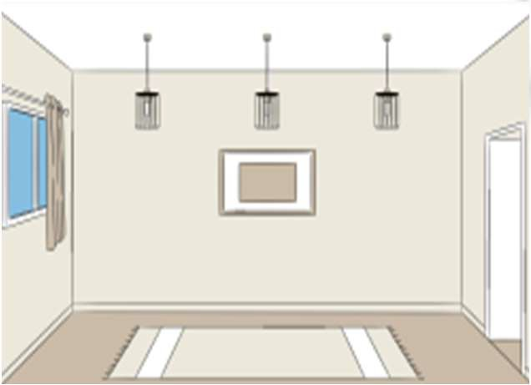
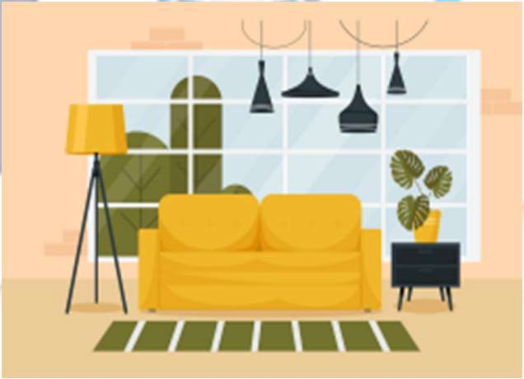
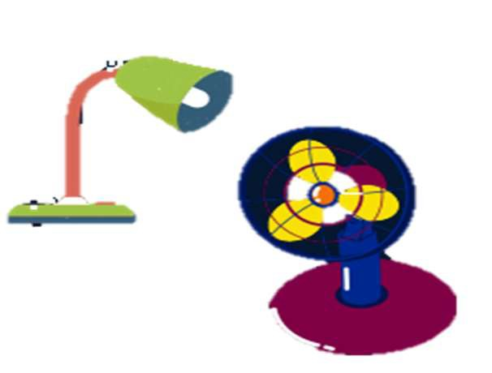
HTML
CSS
Style
JS
Logic
Structure/layout

Slide 3



Slide 4
CSS
Cascading Style Sheet
Itisalanguagethatisusedtodescribethestyleofadocument

Slide 5
Basic Syntax
Selector
h1{
color: red ;
}
Property
Value

Slide 6
Including Style
Inline
<h1 style=“color: red;”>Paarsh Infotech </h1>
<style> tag internal
<style>
h1{
color: red;
}
</style>

Slide 7
Including Style
External CSS
writing CSS in a separate document & linking it with HTML file

Slide 8
Color Property
Usedtosetthecolorofforeground
color : red; color : green; color : blue; color : pink;

Slide 9
Background Color Property
Usedtosetthecolorofbackground
background-color: red; background-color: green; background-color: blue; background-color: pink;

Slide 10
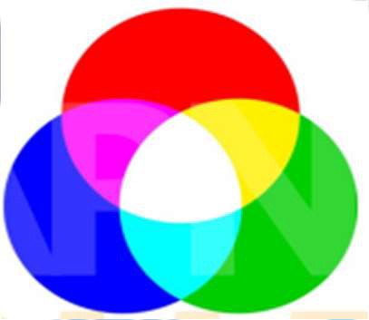
Color Systems
RGB
color: rgb(255, 0, 0);
color: rgb(0, 255, 0);

Slide 11
Color Systems
Hex (Hexadecimal)
color: #ff0000; color: #00ff00;

Slide 12
Selectors
Universal Selector
* { }
Element Selector
h1 { }
Class Selector
.myClass { }
Id Selector
#myid{}

Slide 13
Practice Set 1
Q1: Create a simple div with an id "box".
Add some text content inside the div. Set its background color to blue.
Q2: Create 3 headings with h1, h2 & h3.
Give them all a class "heading" & set color of "heading" to red.
Q3: Create a button & set its background color to :
green using css stylesheet
blue using <style> tag
pink using inline style

Slide 14
Text Properties
text-align
text-align : left / right / center

Slide 15
Text Properties
font-weight
font-weight : normal / bold / bolder / g
font-weight : 100-900

Slide 16
Text Properties
font-family
font-family : arial
font-family : arial, roboto

Slide 17


Generic font families: Generic font families are determined by font family properties such as serifs-which are decorative strokes on the ends of letters-or cursive strokes. The generic font family name will specify the attribute that all fonts within that family share, like serif, sans-serif, or monospace.
Specific font families: Specific font families are specific fonts with different styles within the one font family name, such as Arial, Times New Roman, and Tahoma.
5 Generic Font Families
Here is an overview of the generic font families found in many word processing programs
Serif: Serif fonts are traditional typefaces using characters that have serifs which are sma.11 winged or flared tips extending off the tips of a letter. Serif fonts are typically used in printed books, newspapers, and magazines. Some popular serif fonts include nmes New Roman, Garamond, Palatino, and Georgia.
Sans-Serif: Sans-serif fonts use characters without serifs and are more commonly seen in digital formats. A sans-serif font will typically be the default font in digital word processing programs. Sans-serif fonts include Arial, Helvetica, Verdana, Trebuchet MS, and Gill Sans.
Cursive: Cursive fonts use characters that have connective strokes which give the font a handwritten appearance. Cursive fonts include Comic Sans MS, Adobe Poetica, Sanvito, and Zapf-Chance,y.
Fantasy: Fantasy fonts are stylized fonts that still maintain the characteristics of non-cursive. traditional alphabet glyphs. Examples include Cottonwood, Critter, and Alpha Geometrique.
Monospace: Fonts In the monospace font family have characters that are all the same width, giving text the appearance of a manual monospaced typewriter. Examples of monospaced fonts include Courier New, Monaco, Luclda Console, Consolas, and Everson Mono.

Slide 18
Text Properties
line-height
line-height : 2px line-height : 3
line-height : normal

Slide 19
Text Properties
text-transform
text-transform : uppercase / lowercase / capitalize / none

Slide 20
Units in CSS
Absolute
pixels (px)
96px = 1 inch font-size: 2px

Slide 21
Practice Set 2
Q1: Create a heading centered on the page with all of its text capitalized
by default.
Q2: Set the font family of all the content in the document to "Times New Roman".
Q3: Create one div inside another div.
Set id & text "outer" for the first one & "inner" for the second one. Set the outer div text size to 25px & inner div text size to 10px.

Slide 22



Slide 23
Box Model in CSS
Height
Width
Content
Width
Height
Border
Margin
Padding
Padding
Margin
Border

Slide 24
Height
By default, it sets the content area height
div {
height: 50px;
Height
Content
}

Slide 25
Width
By default, it sets the content area width
Width
div {
width: 50px;
Content
}

Slide 26
Border
Used to set an element's border
Content
border-width : 2px;
border-style : solid / dotted / dashed
border-color : black;
Border

Slide 27
Border
Shorthand
border : 2px solid black;

Slide 28
Border Radius
Used to round the corners of an element's outer border edge
border-radius : 10px;
Border border-radius : 50%;

Slide 29
Padding
padding-left
padding-right
padding-top
padding-bottom
Content
Padding

Slide 30
Padding
Shorthand
padding: 50px;
padding: 1px 2px 3px 4px;
top | right | bottom | left -> clockwise

Slide 31
Margin
margin-right
margin-left
Margin
Content
margin-top
margin-bottom

Slide 32
Margin
Shorthand
margin: 50px;
margin: 1px 2px 3px 4px;
top | right | bottom | left -> clockwise

Slide 33
Practice Set 3
Q1 : Create a div with height & width of 100px. Set its background color to green & the border radius to 50%.
Q2: Create the following navbar.

Slide 34

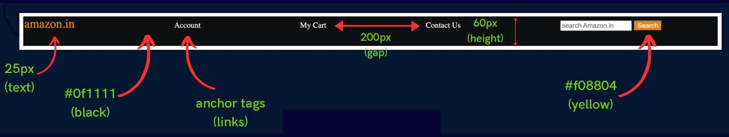

Slide 35
Display Property
display:inline/block/inline-block/none
inline - Takes only the space required by the element. (no margin/ padding)
block - Takes full space available in width.
inline-block - Similar to inline but we can set margin & padding.
none - To remove element from document flow.

Slide 36
Visibility
visibility:hidden;
Note: When visibility is set to none, space for the element is reserved.
But for display set to none, no space is reserved or blocked for the element.

Slide 37
Alpha Channel
opacity (0 to 1)
RGBA
color: rgba(255, 0, 0, 0.5);
color: rgba(255, 0, 0, 1);

Slide 38
Practice Set 4
Q1- Create a webpage layout with a header, a footer & a content
area containing 3 divs. Set the height & width of divs to 100px. (add the previous navbar in the header)
Q2: Add borders to all the divs.
Q3: Add a different background color to each div with an opacity of 0.5
Q4: Give the content area an appropriate height.

Slide 39




Slide 40
Units in CSS
Relative
%
em rem

Slide 41
Percentage (%)
It is often used to define a size as relative to an element's parent
width : 33% ; margin-left : 50%

Slide 42
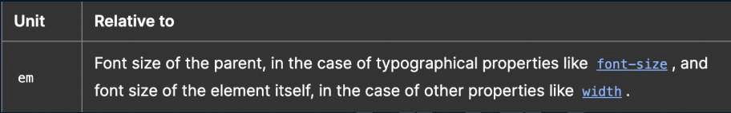
Em

Slide 43

Rem (Root Em)

Slide 44
Others
vh: relative to 1% viewport height
vw : relative to 1% viewport width

Slide 45
Position
The position CSS property sets how an element is positioned in a document.
position:static/relative/absolute/fixed

Slide 46
Position
static - default position (The top, right, bottom, left, and z-index properties have no effect)
relative - element is relative to itself. (The top, right, bottom, left, and z-index will work)
absolute - positioned relative to its closest positioned ancestor. (removed from the flow)
fixed - positioned relative to browser. (removed from flow)
sticky - positioned based on user's scroll position

Slide 47
z-index
It decides the stack level of elements
Overlapping elements with a larger z-index cover those with a smaller one.
z-index : auto (0)
z-index : 1 / 2 / ...
z-index : -1 / -2 / ...

Slide 48
Background Image
backg
background-image:url("image.jpeg");

Slide 49
Background Size
background-size:cover/contain/auto

Slide 50
Practice Set 5
Qs: Create the following layout using the given html.
Give the div a height, width & some background image.
Use the appropriate position property for the div element to place it at the right end of the page. (The div should not move even on scroll)
Use z-index to place the div on top of page.
<p>lorem*5</p>
<div>Love Nature</div>
<p>lorem*5</p>

Slide 51



Slide 52
Flexbox
Flexible Box Layout
It is a one-dimensional layout method for arranging items in rows or columns.

Slide 53
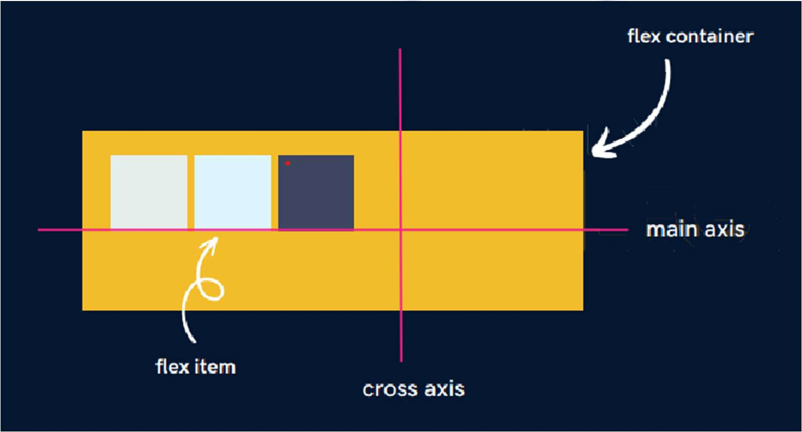
The Flex Model

Slide 54
Flexbox Direction
It sets how flex items are placed in the flex container, along which axis
flex-direction : row; (default)
flex-direction : row-reverse;
flex-direction : column;
flex-direction : column-reverse;

Slide 55
Flex Properties
for Flex Container
justify-content : alignment along the main axis.
flex-start / flex-end / center / space-evenly /
justify-content is a CSS property that is used to align and distribute the flex items (or content) along the main axis of a flex container. It controls the horizontal alignment of items within a flex container.
flex-wrap : nowrap / wrap / wrap-reverse.
align-items : alignment along the cross axis.
align-content : alignment of space between & around the content along cross-axis.

Slide 56
Flex Properties
for Flex Item
align-self : alignment of individual along the cross axis.
flex-grow : how much a flex item will grow relative to the rest of the flex items if space is available.
flex-shrink : how much a flex item will shrink relative to the rest of the flex items if space is available.

Slide 57
Practice Set 6
Qs-1: Create a navbar with 4 options in the form of anchor tags
inside list items. Now, use flexbox to place them all spaced equally in a single line.
Qs-2: Use flexbox to center one div inside another div.
Qs-3: Which has higher priority - align-items or align-self?

Slide 58
Media Queries
Help create a responsive website
@media width : 600px
div {
background-color : red;
}
}
@media min-width : 600px) { div {
background-color : red;
}
}

Slide 59
Media Queries
@media min-width : 200px) and min-width : 300px
div {
background-color : red;
}
}

Slide 60
Practice Set 7
Qs: Add a media query to implement the following:
the color of a div changes to green for viewport width less than 300px.
the color of a div changes to pink for width between 300px & 400px.
the color of a div changes to red for width between 400px & 600px.
the color of a div changes to blue for width above 600px.

Slide 61



Slide 62
Transitions
Transitions enable you to define the transition between two states of an element.
transition-property : property you want to transition (font-size, width etc.)
transition-duration : 2s / 4ms ..
transition-timing-function : ease-in / ease-out / linear / steps ..
transition-delay : 2s / 4ms ..

Slide 63
Transition Shorthand
property name | duration | timing-function | delay
transition: font-size 2s ease-in-out 0.2s;

Slide 64
CSS Transform
Used to apply 2D & 3D transformations to an element
rotate
transform: rotate(45deg);

Slide 65
CSS Transform
Scale
transform: scale(2); transform: scale(0.5); transform: scale(1, 2);
transform: scaleX(0.5); transform: scaleY(0.5)

Slide 66
CSS Transform
Translate
transform: translate(20px); transform: translate(20px,50px);
transform: translateX(20px); transform: translateY(20px)

Slide 67
CSS Transform
Skew
transform:skew(20deg);

Slide 68
Animation
To animate CSS elements
@keyframemyName{
from{font-size:20px;} to{font-size:40px;}
}

Slide 69
Animation Properties
animation-name
animation-duration
animation-timing-function
animation-delay
animation-direction

Slide 70
Animation Shorthand
animation:myName2slinear3sinfinitenormal

Slide 71
% in Animation
@keyframemyName{
0%{font-size:20px;} 50%{font-size:20px;} 100%{font-size:40px;}
}

Slide 72
Practice Set 8
Qs: Create a simple loader using CSS
Step1 : create a div with circular shape & a thick border from one end (top/bottom/left/right)
Step2 : To make it spin create an animation which transforms it from 0deg to 360deg
Step3 : Add the animation property to the loader with infinite duration

Slide 73




